Slide 1
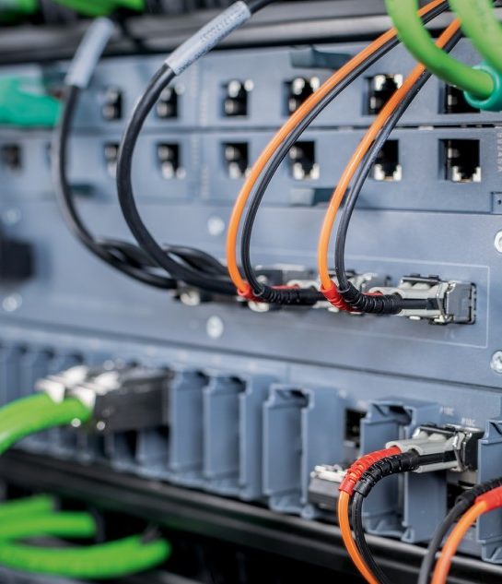
SyncESMC
ITU-T G.781 Multi-Clock ESMC Implementation
©2022 SyncMonk Technologies | www.syncmonk.net | info@syncmonk.net

Slide 2
Introduction
SyncMonk is an early stage bootstrapped startup founded in 2020. We are based in Bangalore, India with main focus on time synchronization services and products. SyncMonk provides complete integration services to Telecom, Networking and Semiconductor companies.
SyncMonk believes in innovating things and is working on the Time Services portfolio including software and hardware solutions.
Solutions offered by SyncMonk are:
SyncESMC v1.0 an ESMC implementation based on ITU-T standard,
FishEye - Set your Vision Clock Monitoring tool for sync and time services
SyncPTP ptp stack optimized and in compliance with IEEE 1588-2019 standard and respective profiles.
www.syncmonk.net| info@syncmonk.net

Slide 3

Agenda
Overview
Why SyncESMC
Architecture
Design GOALS
Configuration
Packet Engine
ESMC State Machine
Hardware Abstraction Layer (HAL)
External Interface
FishEye
Demo Video
www.syncmonk.net| info@syncmonk.net

Slide 4
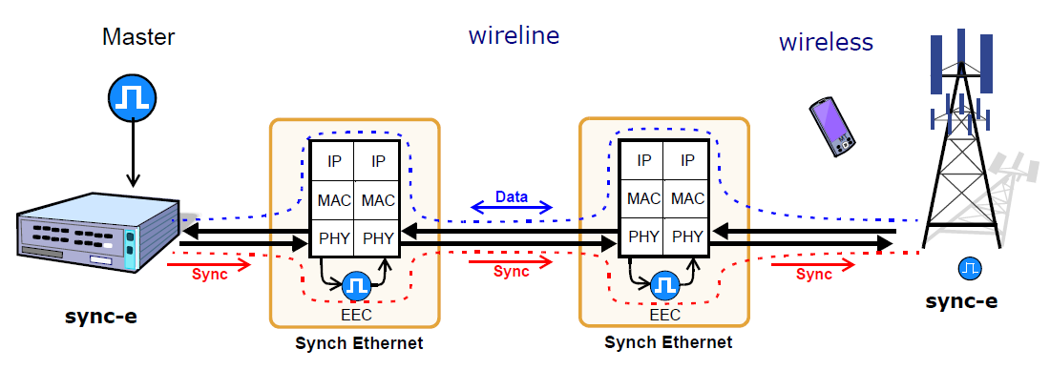
Overview
ESMC is a Logical Channel which transmits SSM information.
The SSM information determines the Quality level of EEC.
It is based on ITU-T G.8264 (03/2018) and ITU-T G.781 (04/2020)
Ethernet SSM is ITU-T-defined Ethernet Slow Protocol.
www.syncmonk.net| info@syncmonk.net

Slide 5
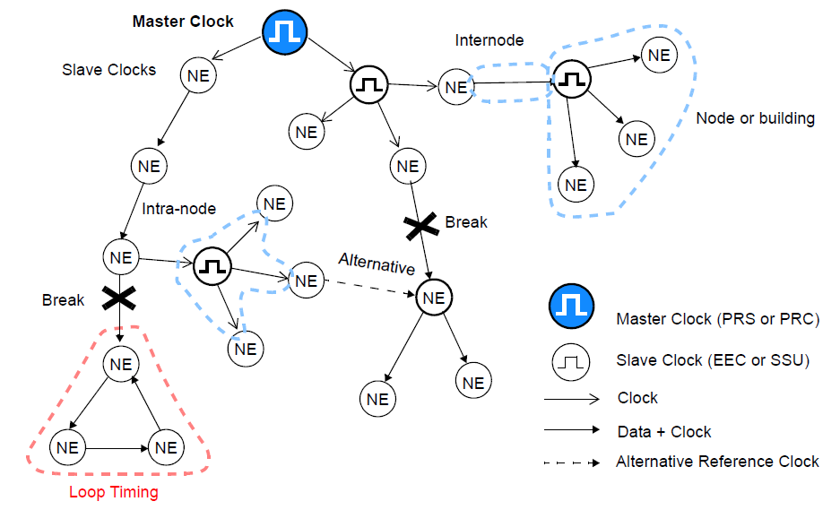
Synchronization Network Topology
www.syncmonk.net| info@syncmonk.net

Slide 6
Why SyncESMC
Hardware Abstracted ESMC stack.
Compliant to G.781(04/2020) and G.8264 (03/2018).
Simplified Single Threaded architecture.
Interaction with PTP Stack (to support IWF)
Dynamic configuration support.
Monitoring with FishEye
Supporting Intel® E810XXVDA4T, Renesas® ClockMatrix™ 8A34001 and AuraSemi® 5508 PHC.
www.syncmonk.net| info@syncmonk.net

Slide 7
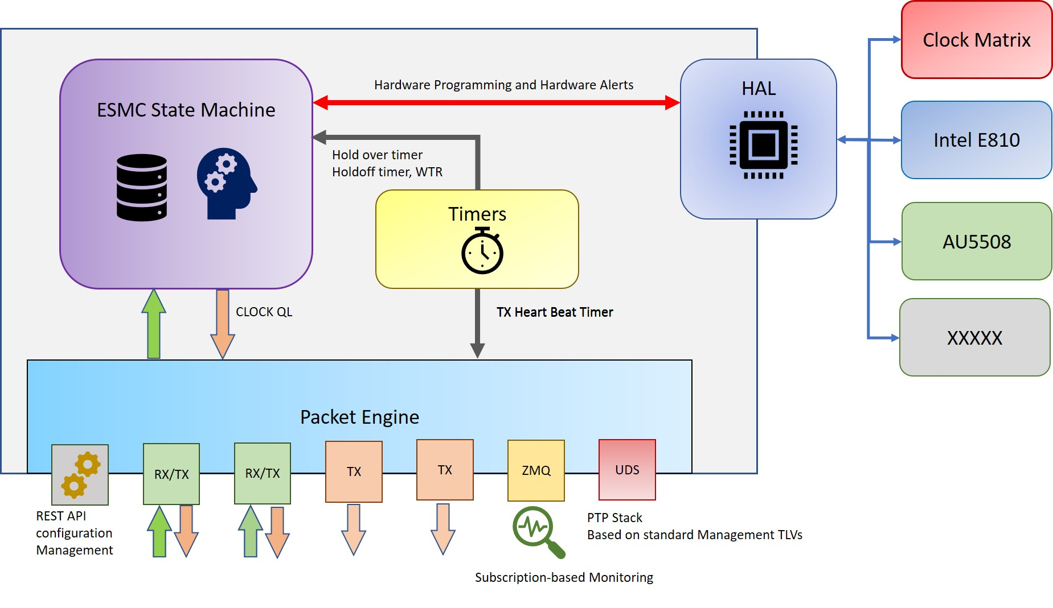
Architecture
www.syncmonk.net| info@syncmonk.net

Slide 8
Design GOALS
Single Threaded architecture.
Multiple hardware support using HAL
Multi Clock Support
External MUX for Input Signals
Futuristic design to support kernel driver support with minimal changes.
Interaction with multi-vendor PTP stacks.
In-built Support for Network configuration and Monitoring
Micro Service compatible for SONiC
www.syncmonk.net| info@syncmonk.net

Slide 9

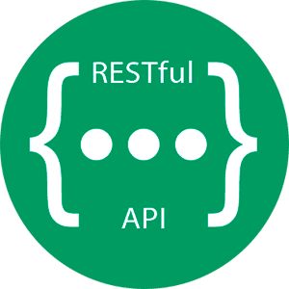
Configuration
Configuration Module has two modes:
Static Configuration Mode
JSON-based configuration file.
System boots up with the predefined configuration
Configuration is majorly classified into
Device
Port
Monitoring
Dynamic Configuration
REST API
Netconf-yang model for O-RAN
www.syncmonk.net| info@syncmonk.net

Slide 10
Packet Engine
Packet Engine is involved with the interface-related activity.
Packet RX
Packet TX
Port Link up/ Link down Events (Network Link)
Packet filtering
Different types of Sockets and interface types are
Separated using packet engine library.
Raw Socket
UDS Socket
APIs
Application
Packet Filter
Link
Events
RX
TX
RTNL
www.syncmonk.net| info@syncmonk.net

Slide 11






ESMC State Machine
Timer
ESMC
State Machine
Core of the ESMC stack.
Interacts with the Packet Engine, Configuration Engine, HAL
Decides to select the source port based on the Best Port Selection Algorithm. (Quality, Priority, Hops)
Handles the timer interrupts for Time outs for Hold off time, no activity on the port, Holdover timeout and Restore timers.
Interacts with HAL to configure the Hardware.
3
5
HAL
2
4
1
Configuration
Packet Engine
Packet Engine updates the packet metadata to Database.
Configuration can be updated run time
Timer-based events for TX packets, Holdover events, and RX timeout events.
Hardware events like LOS, OOF, PLL Loss
PLL ID and PLL input selection instructions to HAL.
www.syncmonk.net| info@syncmonk.net

Slide 12
External MUX for Input Signals
Supports Multiplexing, where it can be configured for the maximum number of Sources available for a PLL and the maximum number of inputs which can be given to the PLL.
Runs an algorithm to select the best ports and based on priority programs the MUX.
Works with any of the available hardware where the number of inputs to PLL is more than the number of sources available. For e.g Broadcom XGS chips for Data Center switches
PLL
MUX
Source
Inputs
www.syncmonk.net| info@syncmonk.net

Slide 13


Hardware Abstraction Layer
Hardware Abstraction Layer.
Hardware vendors can plugin their HAL functions to integrate with SyncESMC.
Ready for Kernel exposed APIs (in future) for controlling the hardware.
Hardware interrupt and status monitoring.
Multiple vendors’ PLLs can be controlled by the same stack.
HAL
(Hardware Abstraction Layer)
www.syncmonk.net| info@syncmonk.net

Slide 14
External Interface
UDS socket can be used to interact with external applications
PTP stack
Seamless integration with any PTP stack over a UDS socket.
SyncESMC can convert Clock Class to Clock quality as per G.8275.2 Annex F.
External Application Interfaces
FishEye
Configurations
PTP
Exchange information on Application-defined TLVs
UDS
SyncESMC
I/F
www.syncmonk.net| info@syncmonk.net

Slide 15
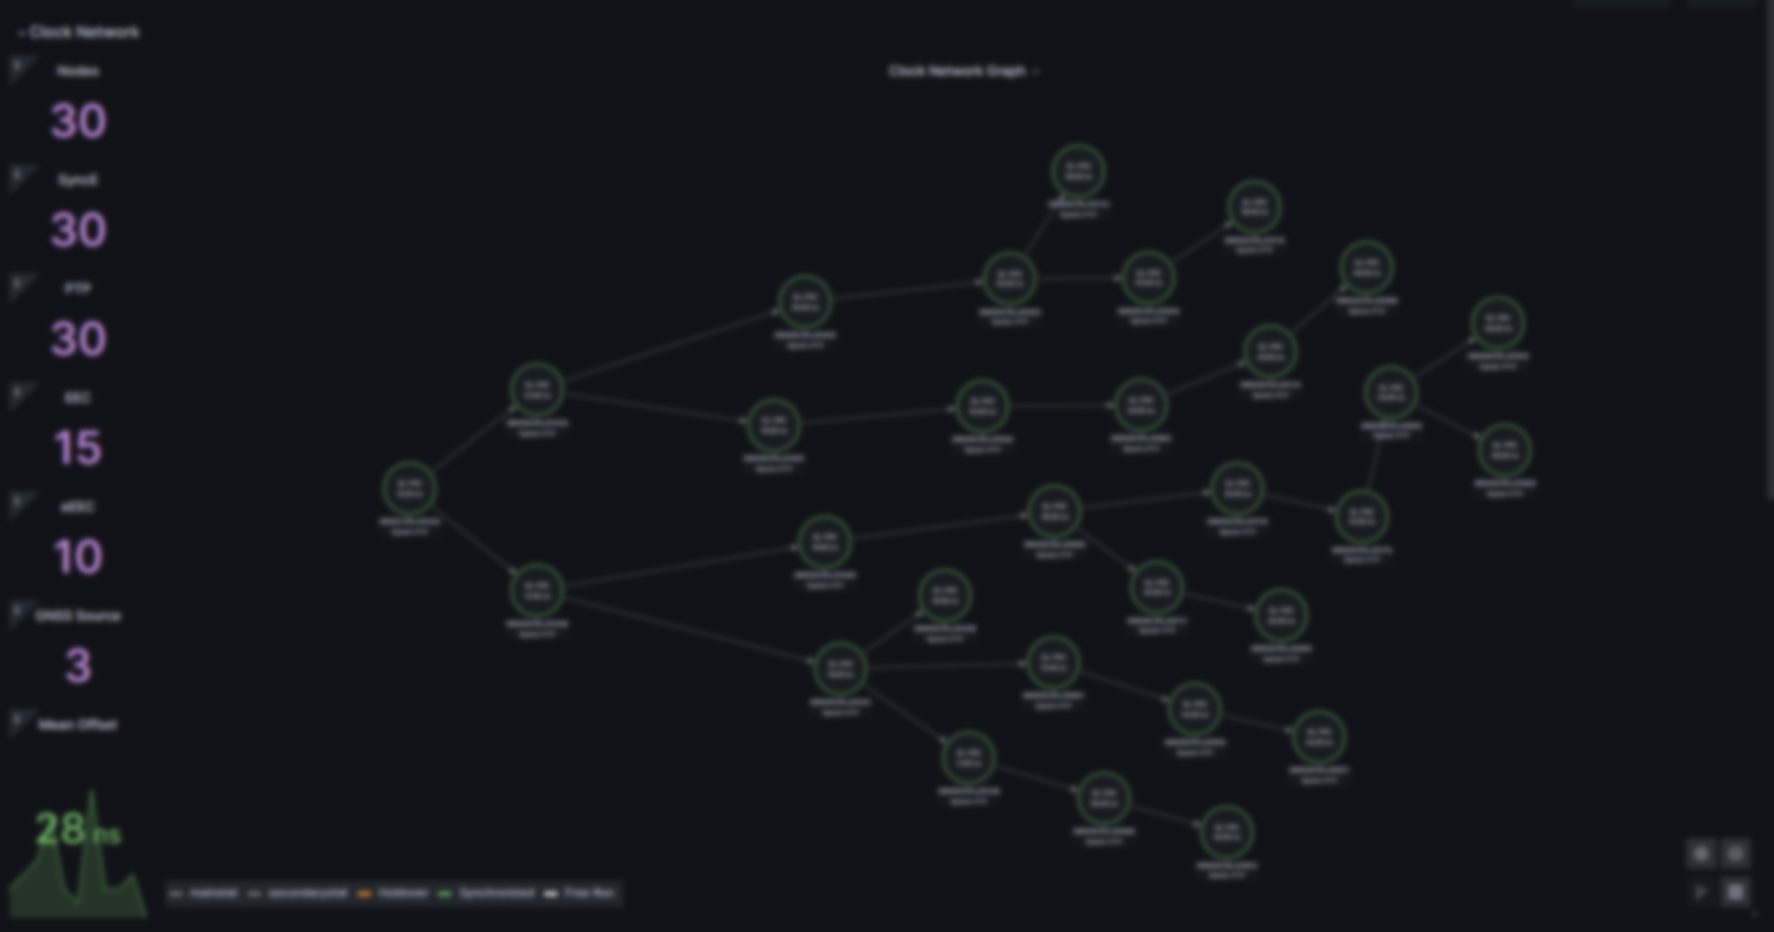

Analyze, Optimize and Monetize your Network

Slide 16
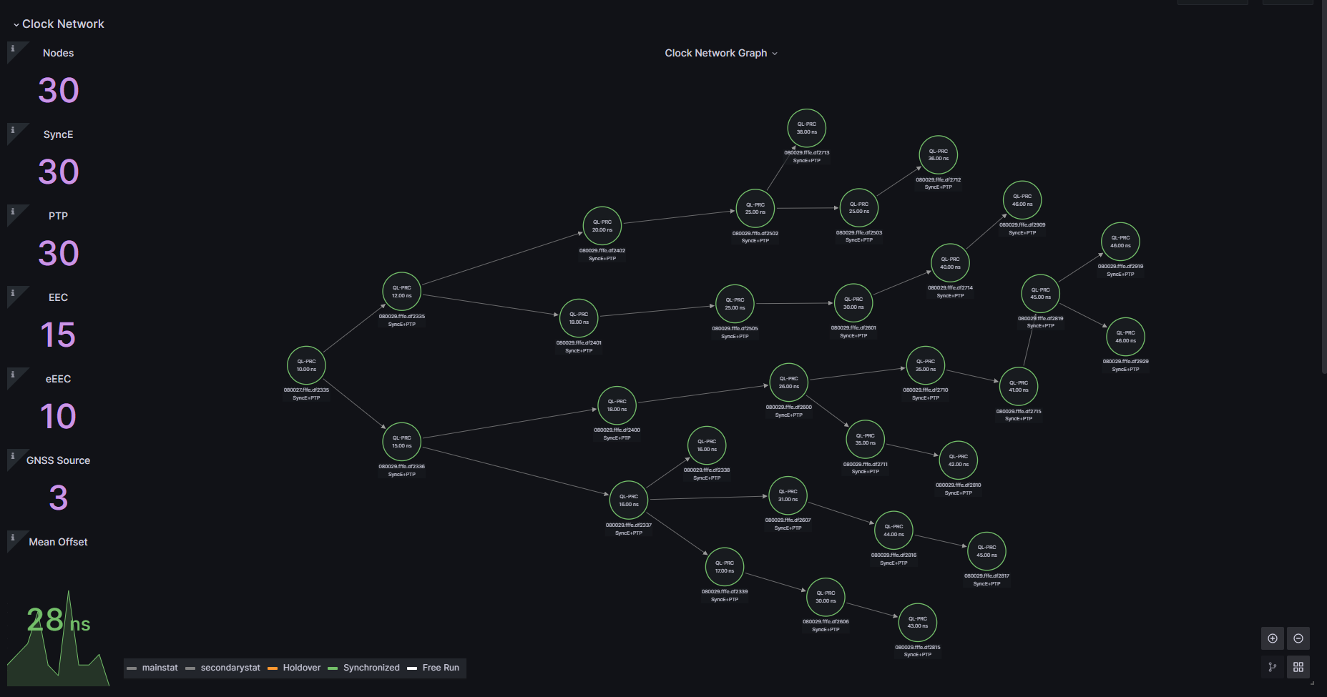
Clock Network Graph

Slide 17
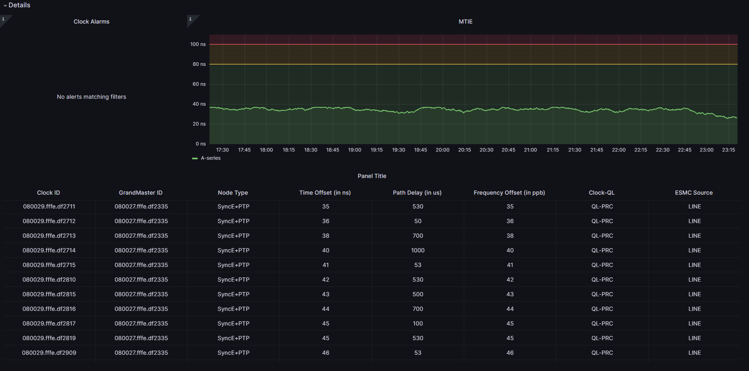
Clock Network Summary

Slide 18
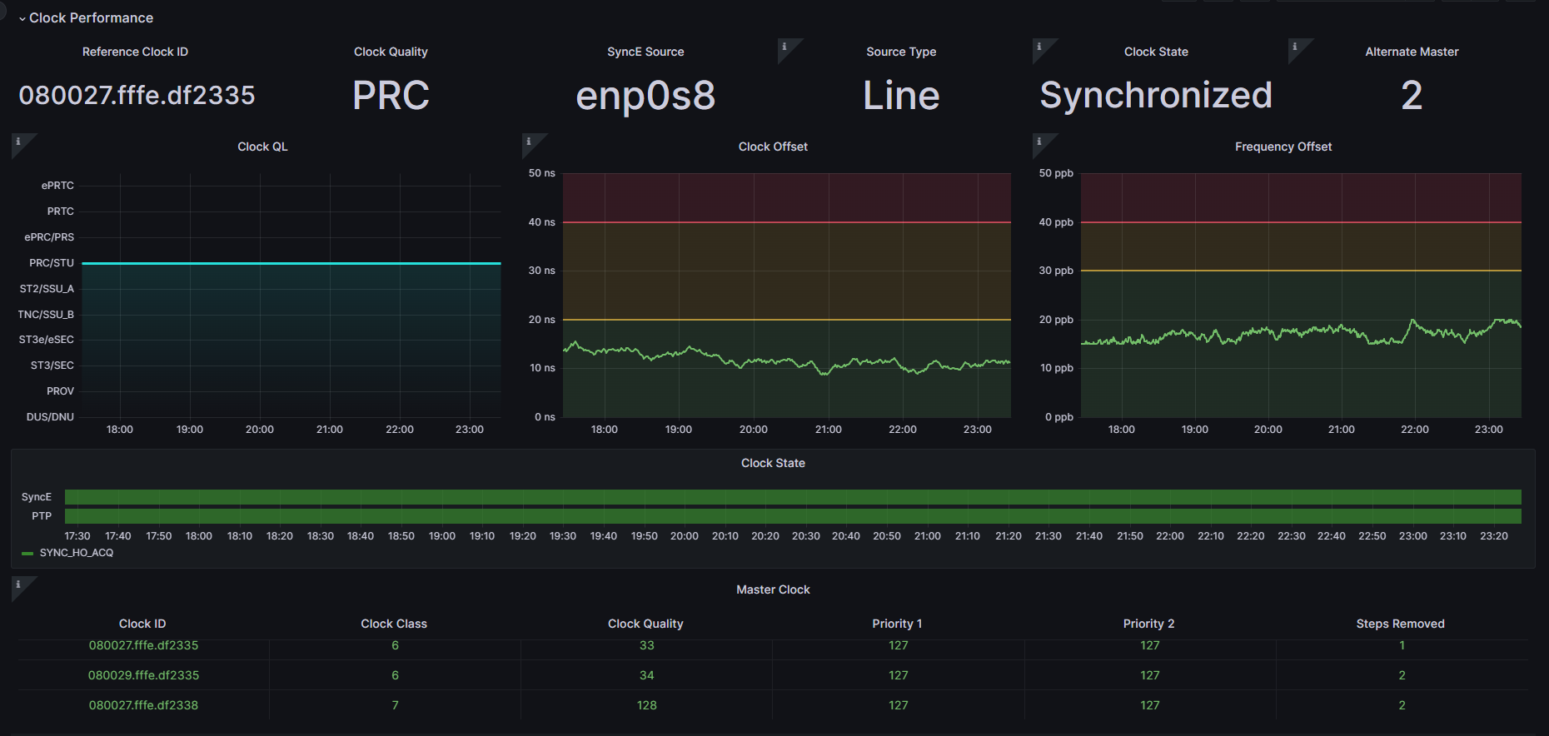
Clock Performance

Slide 19
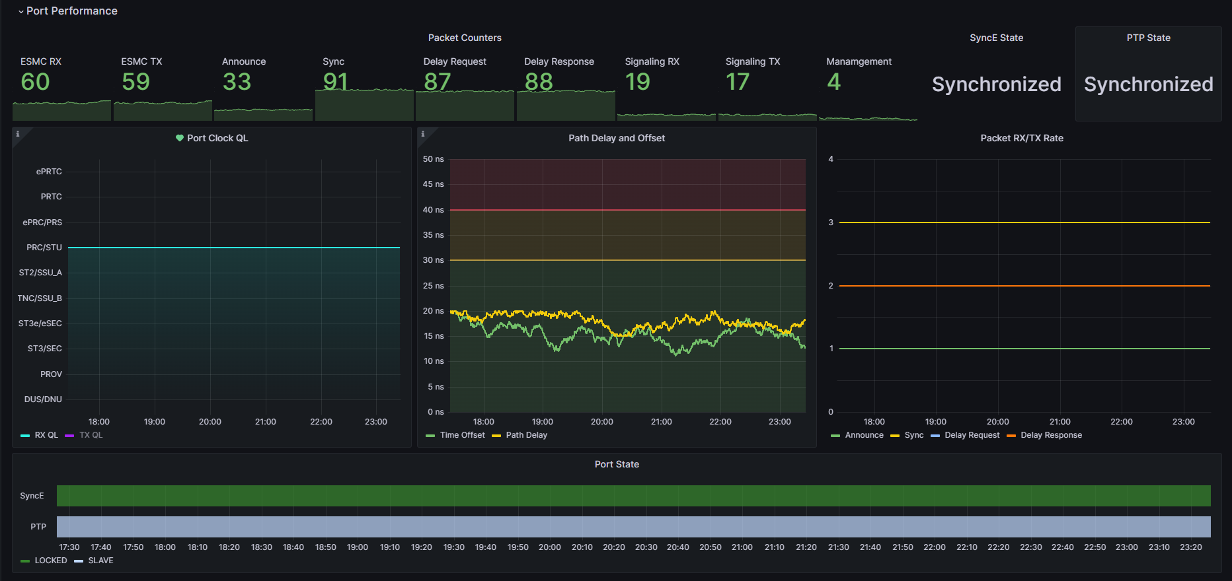
Port Performance

Slide 20
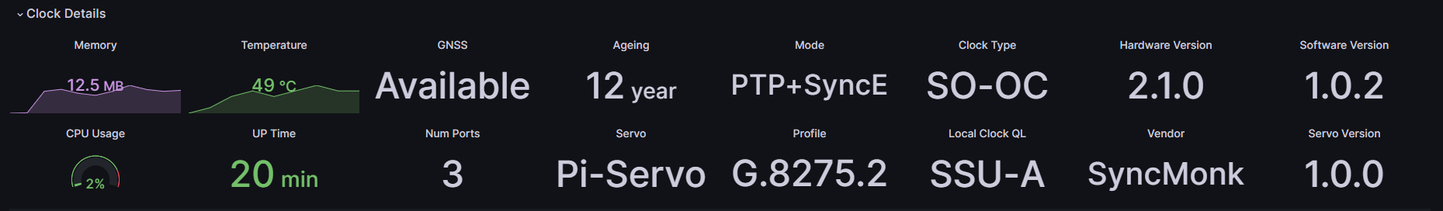
Clock Details

Slide 21
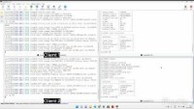

Slide 22





Thank you
 | Contact Us Phone [+91] 984-441-9796 mail: info@syncmonk.net www.syncmonk.net Bangalore-560035 | © 2023 SyncMonk Technologies Product specification and description in this document are subject to change without notice. For latest copy please write us to info@syncmonk.net

